Slide 1
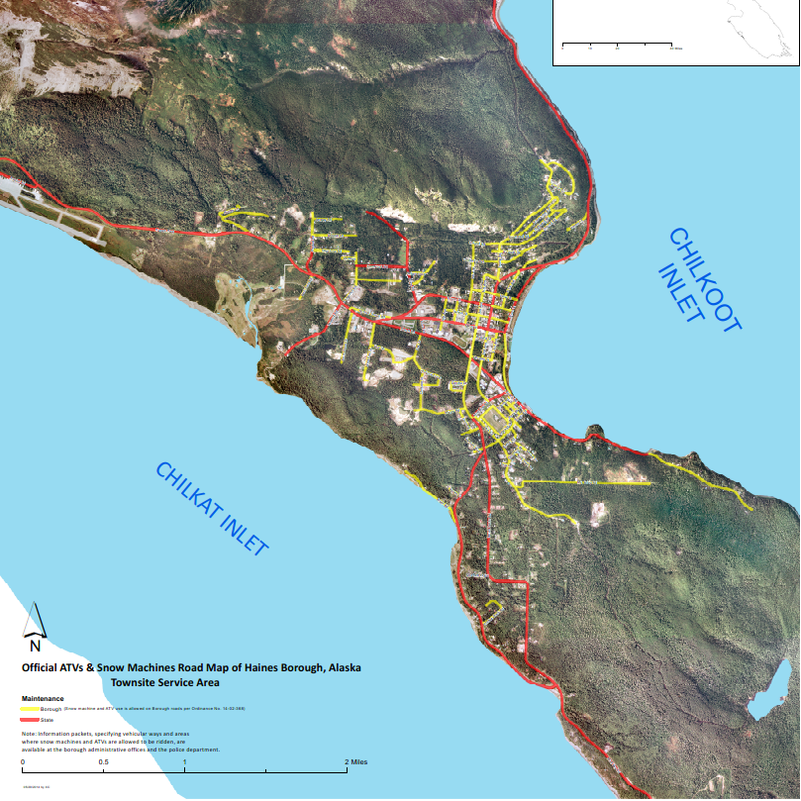
Official ATV and Snow Machine Road Map prior to Jan 2022 regulation change
Red indicates – State Road where ATVs could not operate
Yellow indicates – Borough Roads allowing ATVs
Point of Information:
Past state road restrictions resulted in the downtown area being segmented resulting in limited access to area wide ATV usage as you can see on the old map.

Slide 2
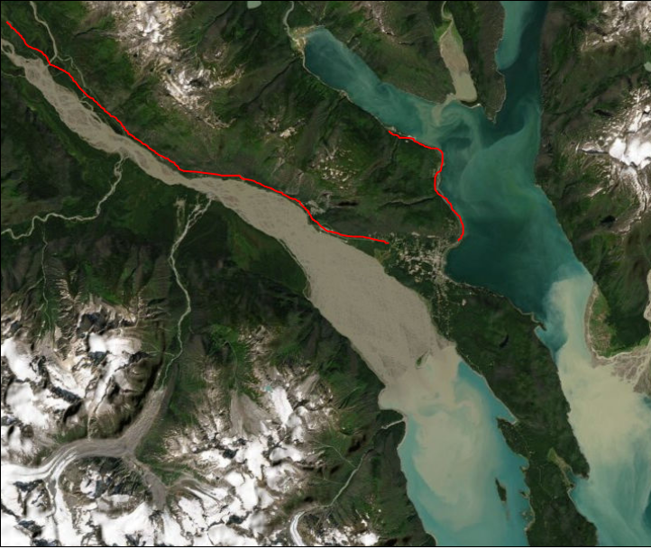
Red lines indicate areas where ATV/APV would not be allowed to operate (posted speed limits exceeding 45 mph).
Haines Hwy at Piedad to the Border
.5 mile Lutak (W’s pullouts) to the Ferry Terminal
Point of Information:
The Jan 2022 regulation change now opens up much of the town site to include Small Tracks Rd and Mud Bay Rd to ATV/APV. – our expectation is that usage will increase as a result of having more accessibility.

