Slide 1
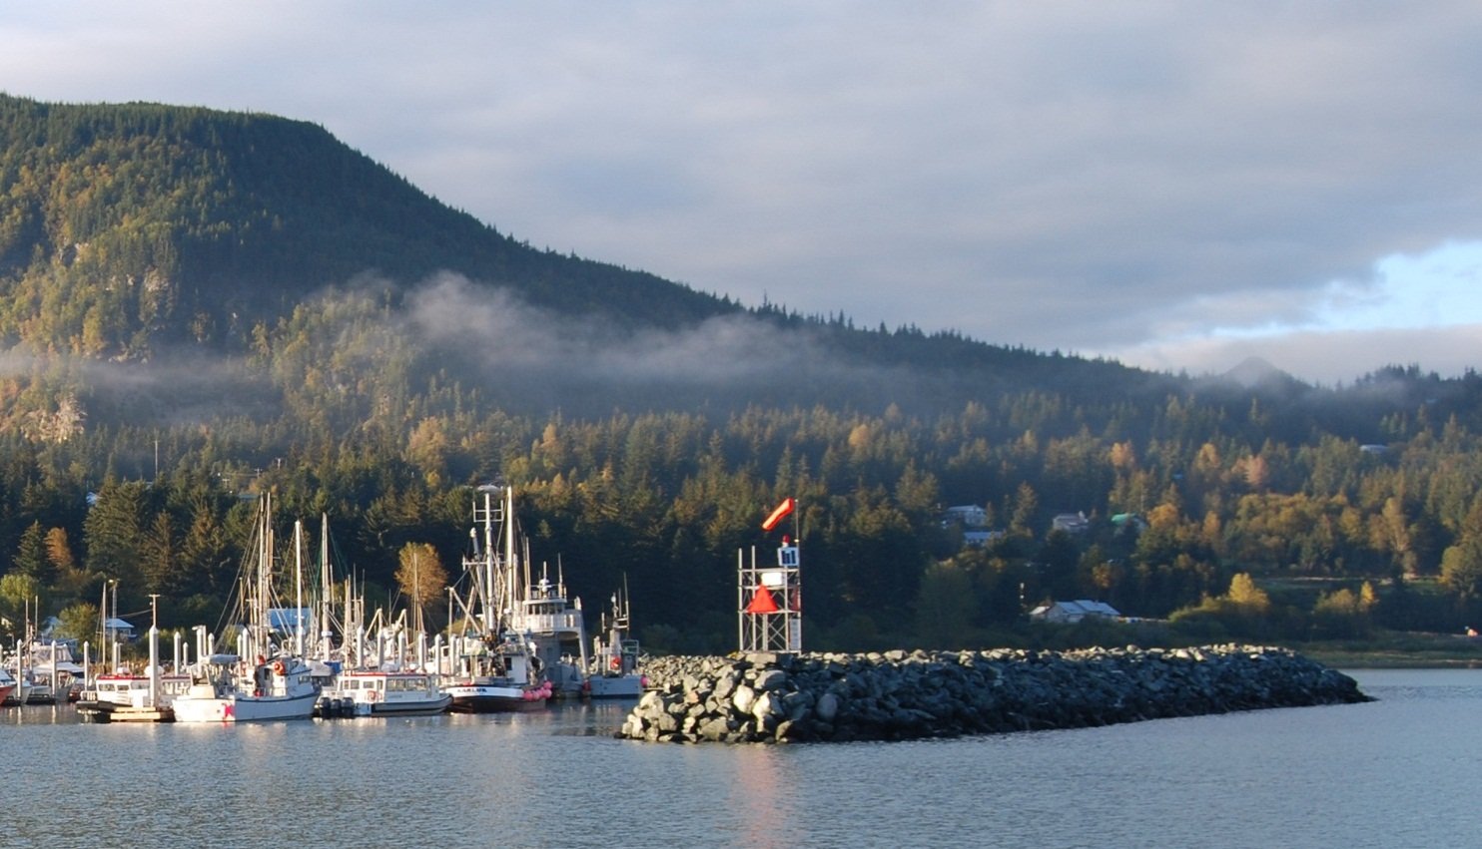
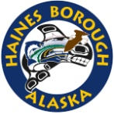
SOUTH PORTAGE COVE EXPANSION
HARBOR PROTECTION ALTERNATIVES
August 27, 2013
Prepared for:
Prepared by:

Slide 2
SOUTH PORTAGE COVE HARBOR EXPANSION
Summary of Alternatives
 | Breakwater Alternative | Initial Cost ($ million) | 50 year Life-Cycle Cost | Comments
1 | Rubble-Mound (rock) Breakwater w/Wick Drains | $16.0 M | $16.6 M | Wick drains spaced 3 feet on center are needed at an installation cost of approximately $1.5 million to allow the soft sediments to consolidate during a 215 day construction period. The project cannot be feasibly constructed without wick drains. Costs assume relatively expensive locally sourced rock. Costs may be reduced by sourcing rock from outside SE Alaska.
2 | Partially Penetrating Wave Barrier | $7.8 M | $8.7 M | The least cost alternative, but with higher maintenance costs than a rubble-mound breakwater because of the need to maintain the corrosion protection system.
3a | Floating Breakwater (Chains/Anchors) | $11.5 M | $12.6 M | A floating breakwater can also provide moorage for vessels, but has the least wave protection, and highest maintenance costs and risk.
3b | Floating Breakwater (Piles) | $11.9 M | $13.3 M | A floating breakwater moored with pile clusters provides better wave protection than a breakwater moored with anchors and chains, but with higher load concentrations and risk.

Slide 3
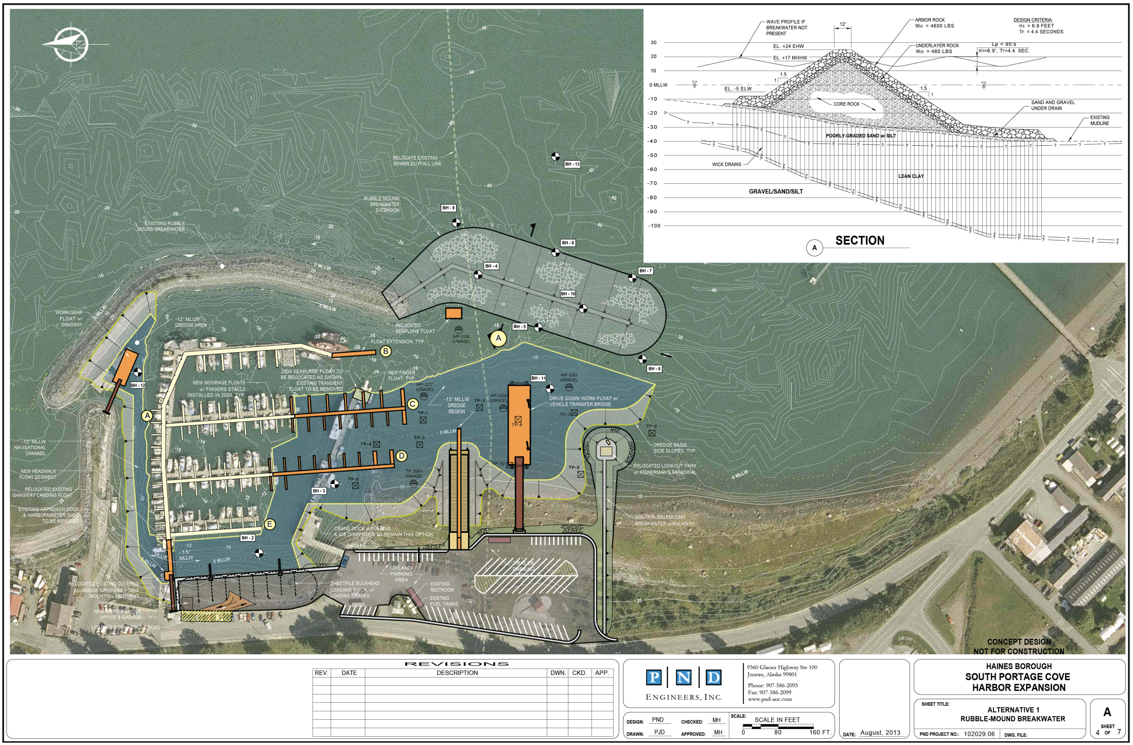
SOUTH PORTAGE COVE HARBOR EXPANSION
Alternative 1 – Rubble-Mound Breakwater

Slide 4
SOUTH PORTAGE COVE HARBOR EXPANSION
Advantages and Disadvantages
Pros: | Cons:
Rubble-mound breakwater construction has been successful at Portage Cove. Rock jetties are usually the least expensive type of breakwater if a good quality rock source is nearby and the foundation is suitable. Maintenance requirements are likely minimal with the high quality rock available in the region. The lack of pile driving is a plus for environmental permitting but may result in a longer work window. | Rubble-mound breakwaters have a larger footprint than other harbor protection alternatives, which, in comparison, can increase the permitting effort and mitigation required. The large volume of material required for construction must be delivered to the site via truck or barge, which may cause adverse impacts in town, especially if it coincides with the summer tourist and cruise ship season Preliminary cost information from a local quarry indicates a relatively high cost for rock from this source.

Slide 5
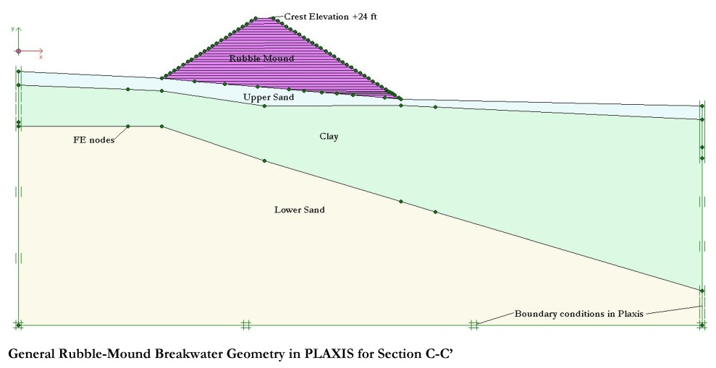
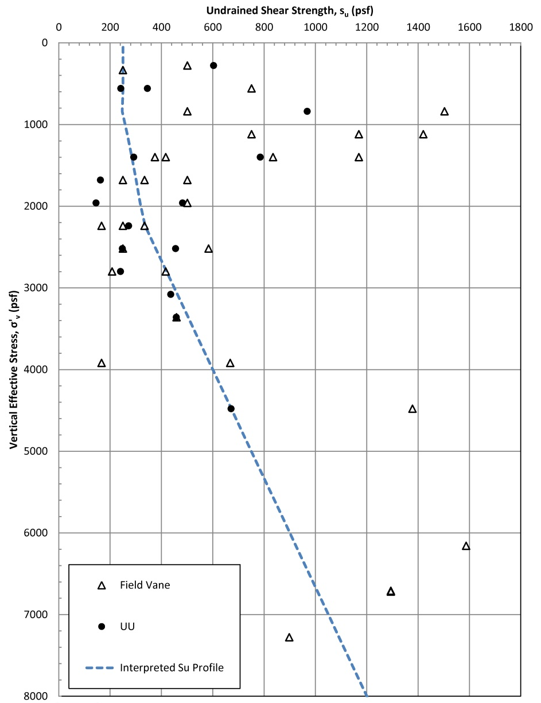
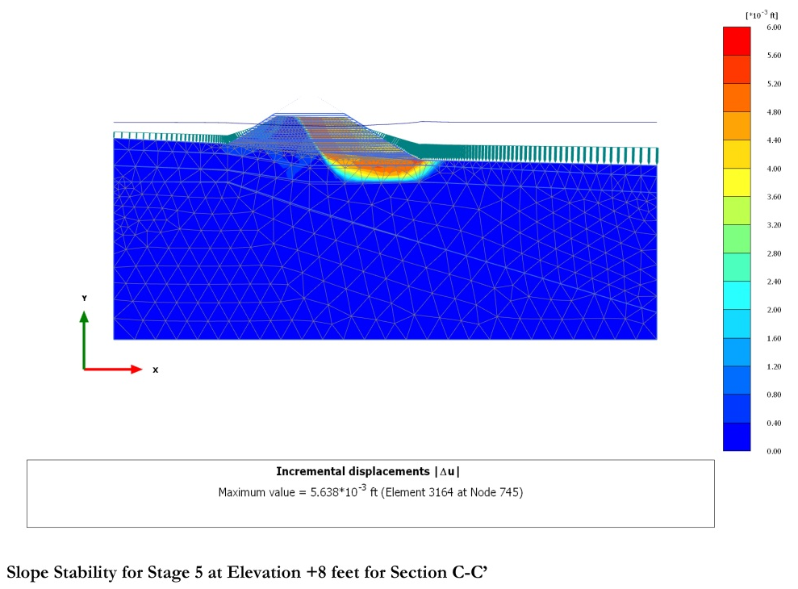
SOUTH PORTAGE COVE HARBOR EXPANSION

Slide 6
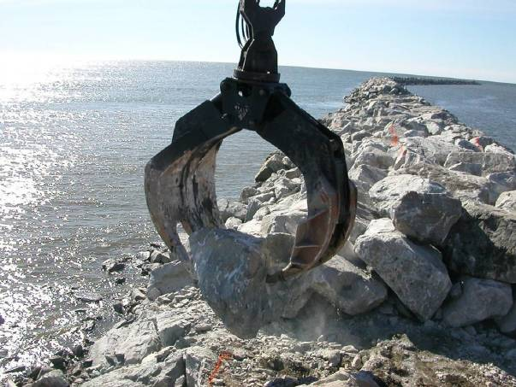
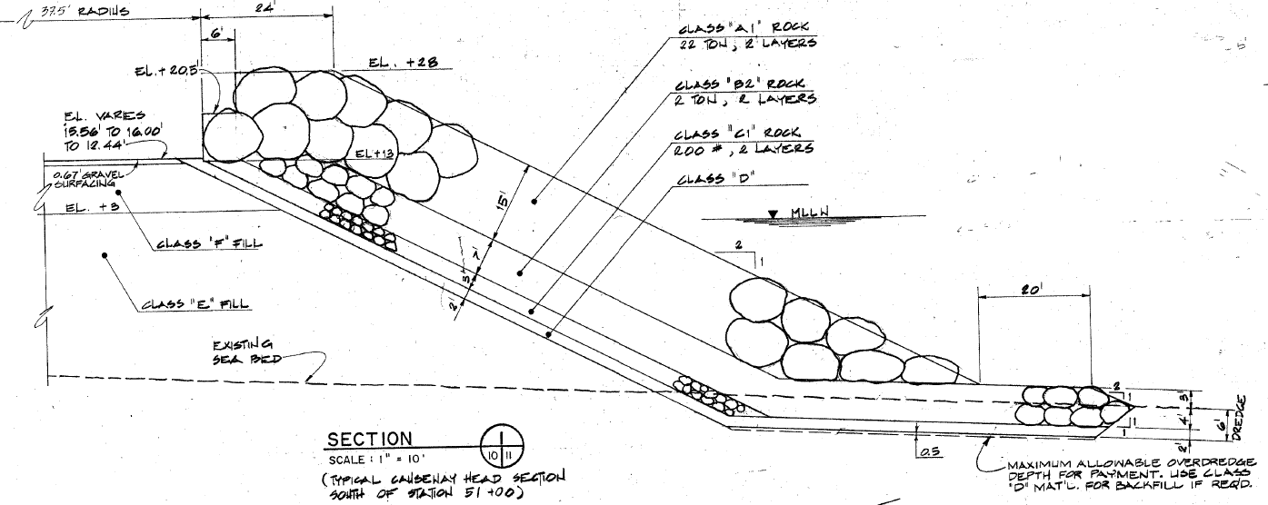
SOUTH PORTAGE COVE HARBOR EXPANSION
Breakwater Technology and Alternatives
Armor rock
Nome, Alaska
BREAKWATER EXAMPLES - CONVENTIONAL MULTI LAYER ROCK

Slide 7
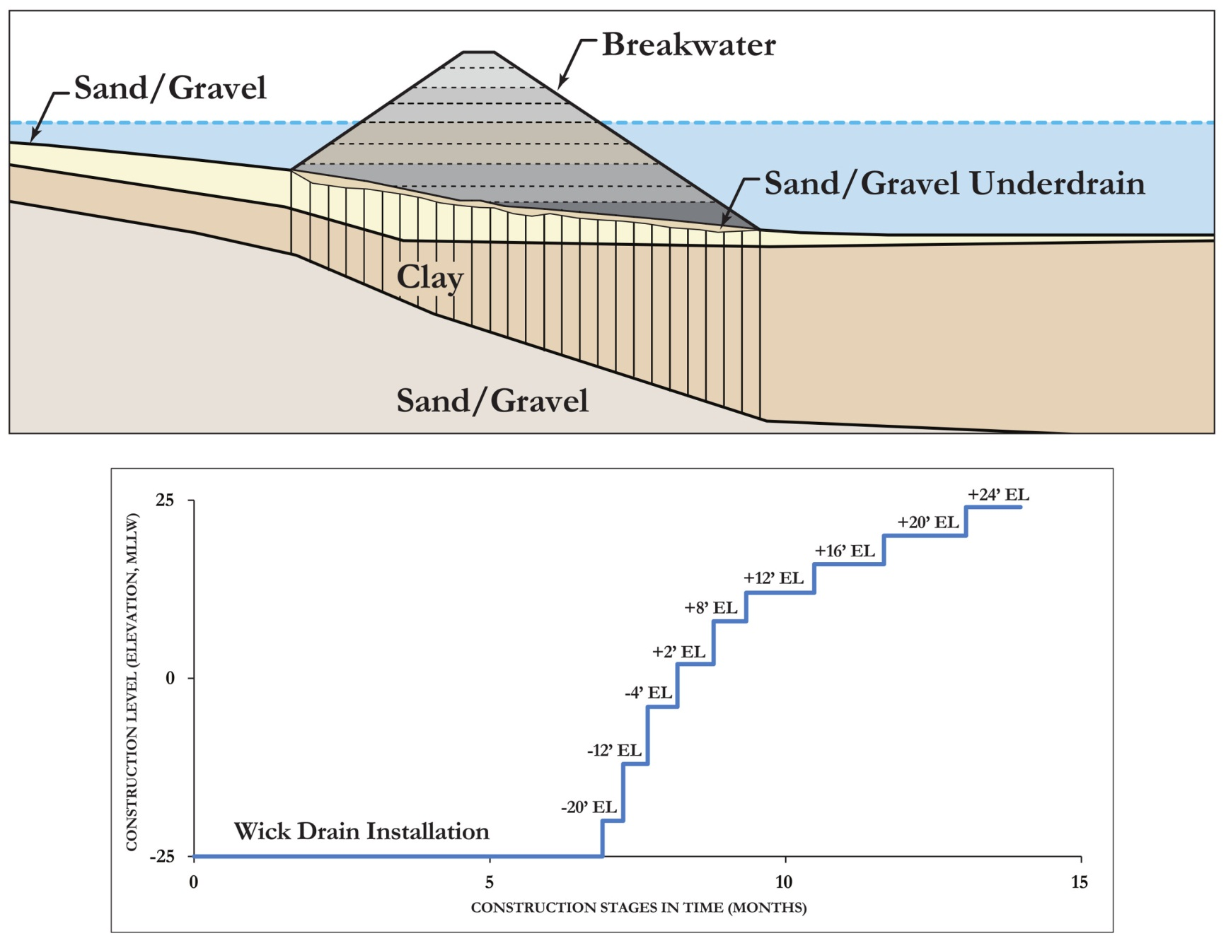
SOUTH PORTAGE COVE HARBOR EXPANSION

Slide 9
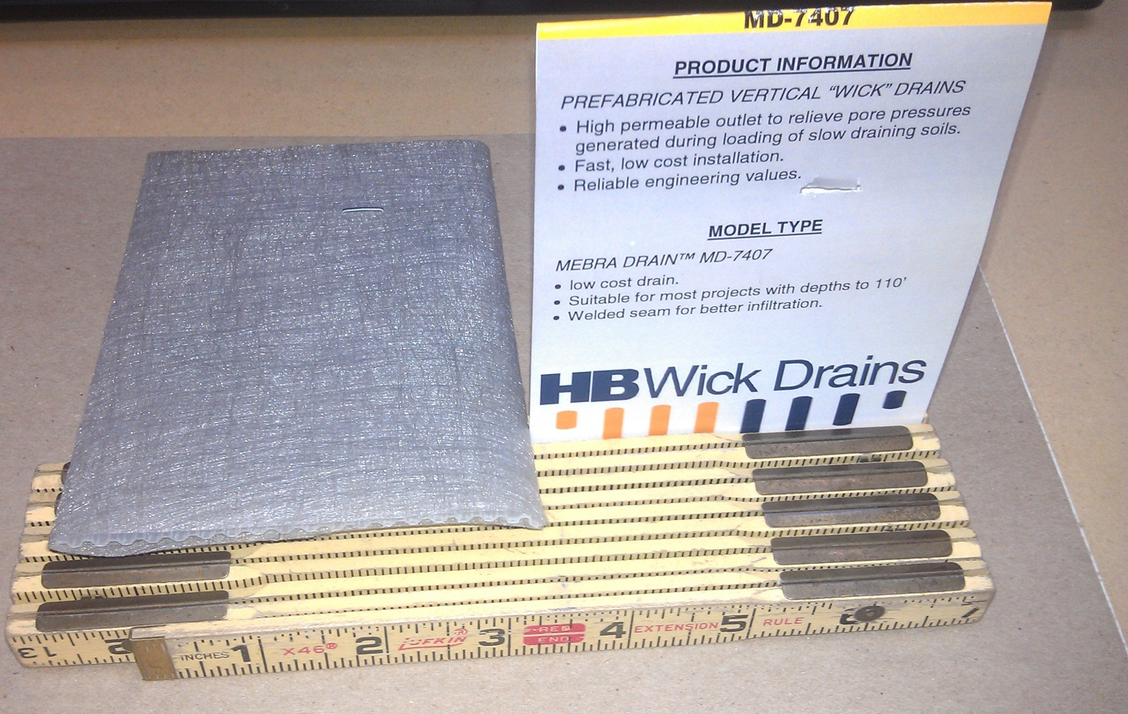
SOUTH PORTAGE COVE HARBOR EXPANSION
Wick drain sample

Slide 10
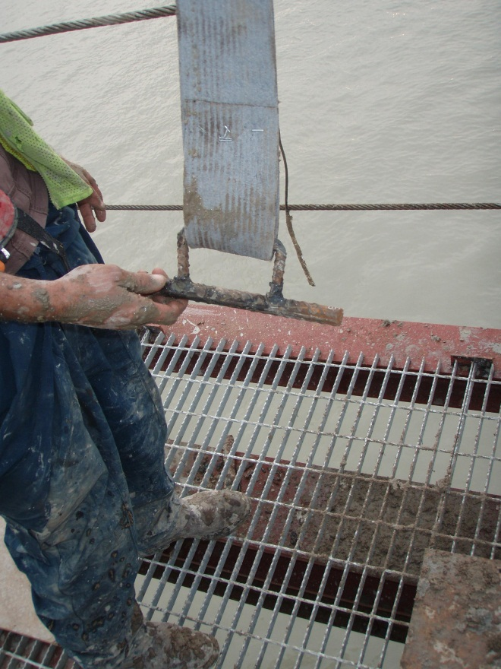
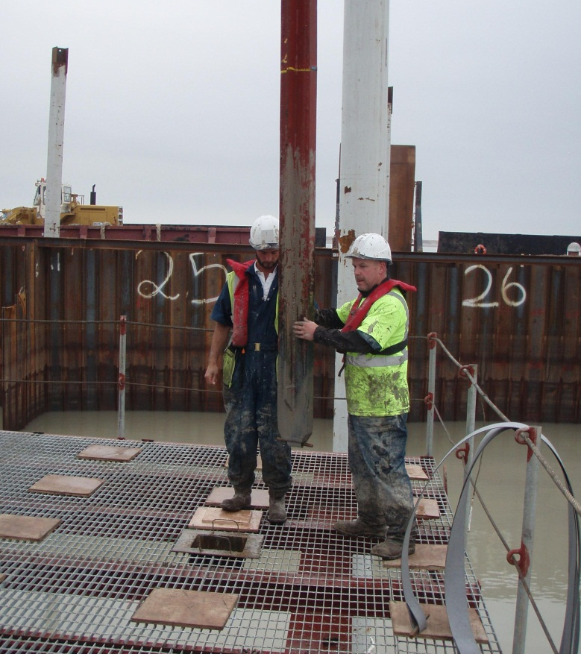
SOUTH PORTAGE COVE HARBOR EXPANSION
Wick drain and mandrel – installation from a barge in Umm Qasr, Iraq.

Slide 11
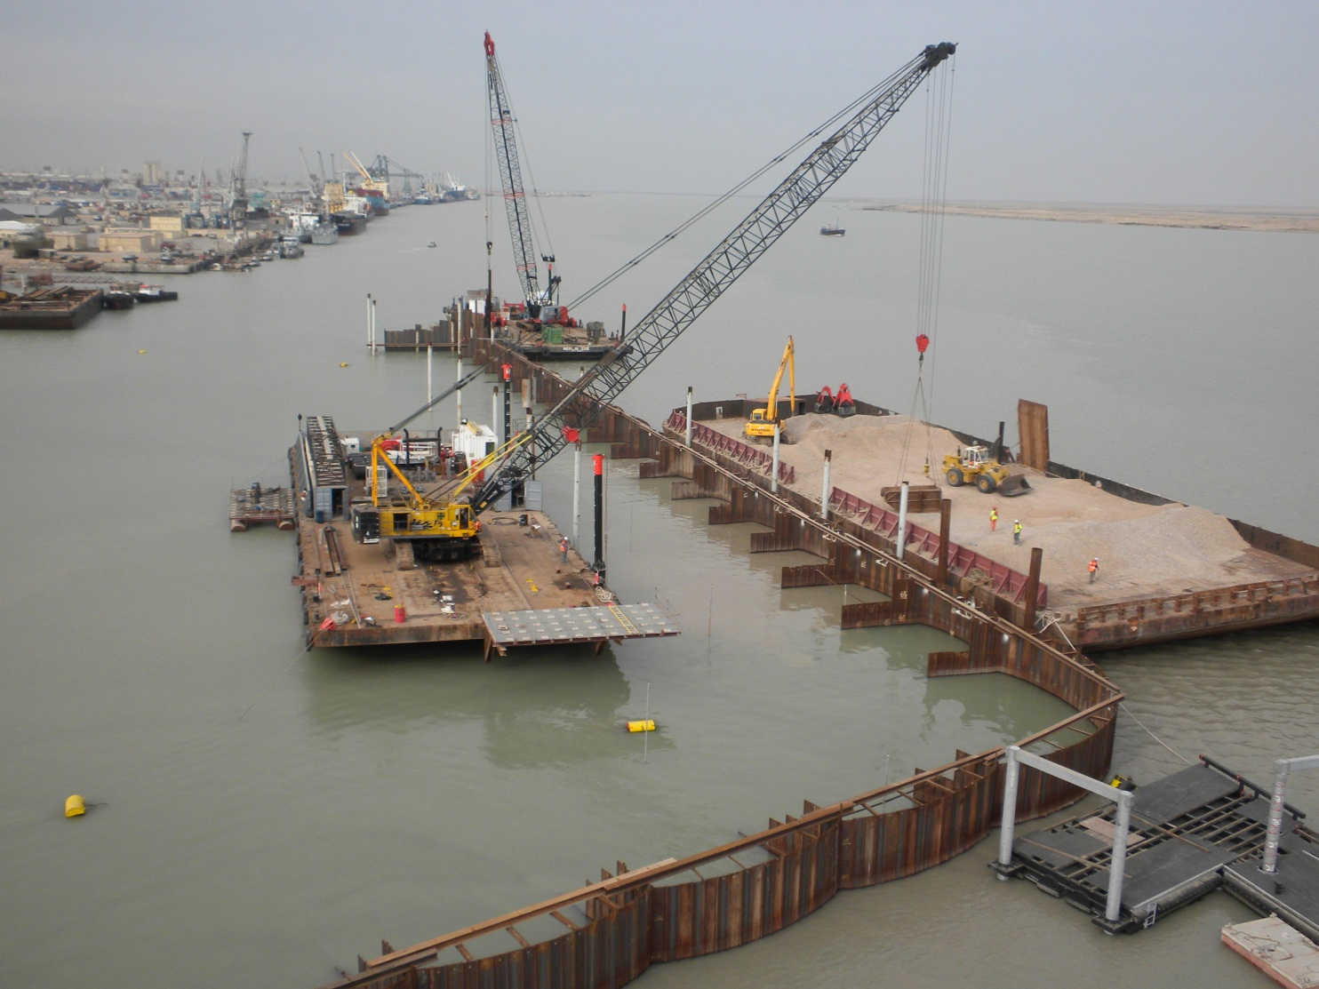
SOUTH PORTAGE COVE HARBOR EXPANSION
Sand for Layer Covering Top of Wick Drains
Wick Drain Template with 5-Foot Grid
Wick drain installation from a barge in Umm Qasr, Iraq.

Slide 12
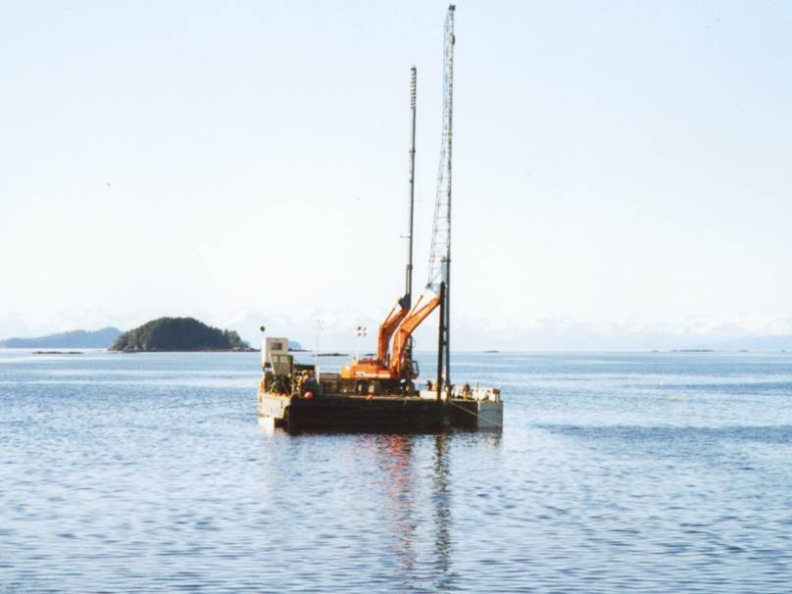
SOUTH PORTAGE COVE HARBOR EXPANSION
Installing Wick Drains from a Barge at Kake, Alaska (photo courtesy Hayward Baker)

Slide 13
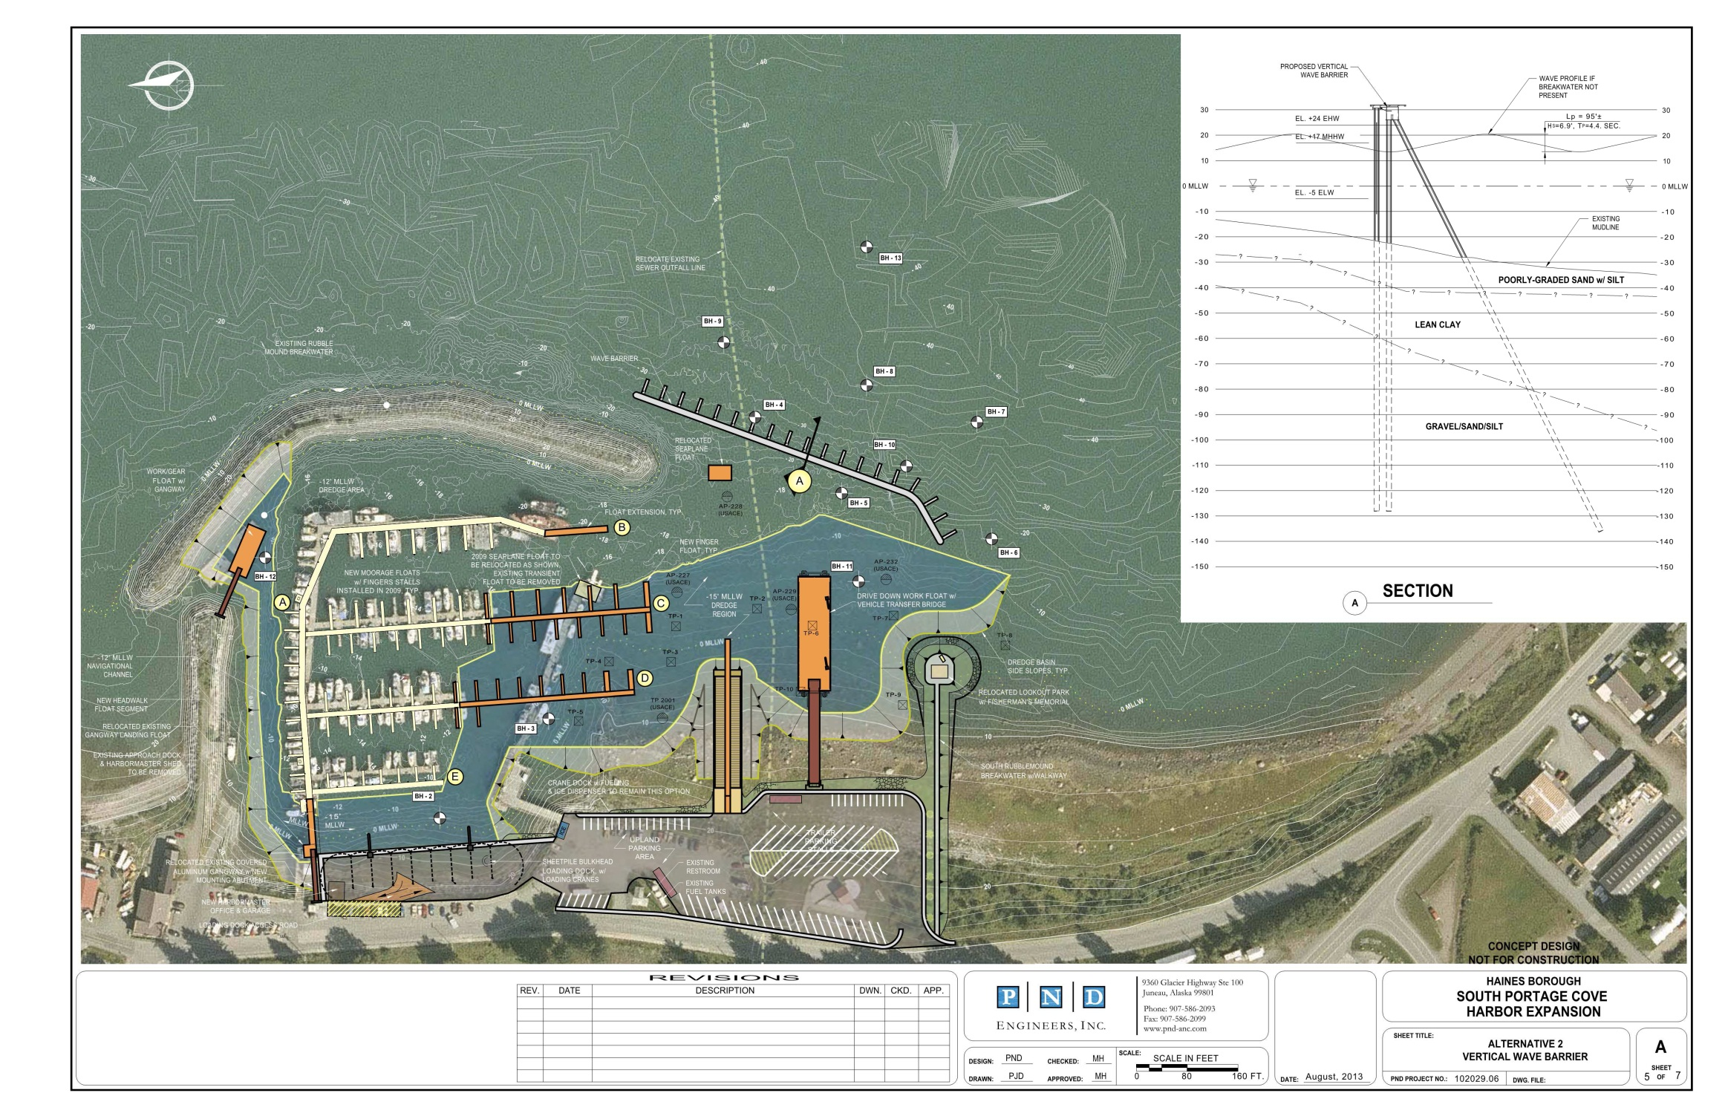
SOUTH PORTAGE COVE HARBOR EXPANSION
Alternative 2 – Vertical Wave Barrier

Slide 14
SOUTH PORTAGE COVE HARBOR EXPANSION
Advantages and Disadvantages
Pros: | Cons:
It is often the only suitable design when space is limited or the waves are too large for a floating breakwater. The small footprint and gap at the bottom for fish passage and circulation likely make this the preferred option for permitting and environmental reasons. Construction is relatively fast with minimal truck traffic, noise, and dust. The vertical wave barrier at Skagway has been successful and is similar to this concept design. A pedestrian promenade can be added to the top at relatively little added cost (not included in cost estimate attached). | More engineering and design effort is needed compared to a rubble-mound breakwater. Additional boreholes or probes may be needed to verify the presence of bedrock at the pile tip elevation. If bedrock is encountered the piles may need to be socketed in the bedrock. Require regular maintenance of anodes and dive inspection to control corrosion. Wave overtopping and spray, and/or wave transmission under the breakwater may be large enough to be objectionable. Overtopping can be controlled somewhat by raising the wall height.

Slide 15
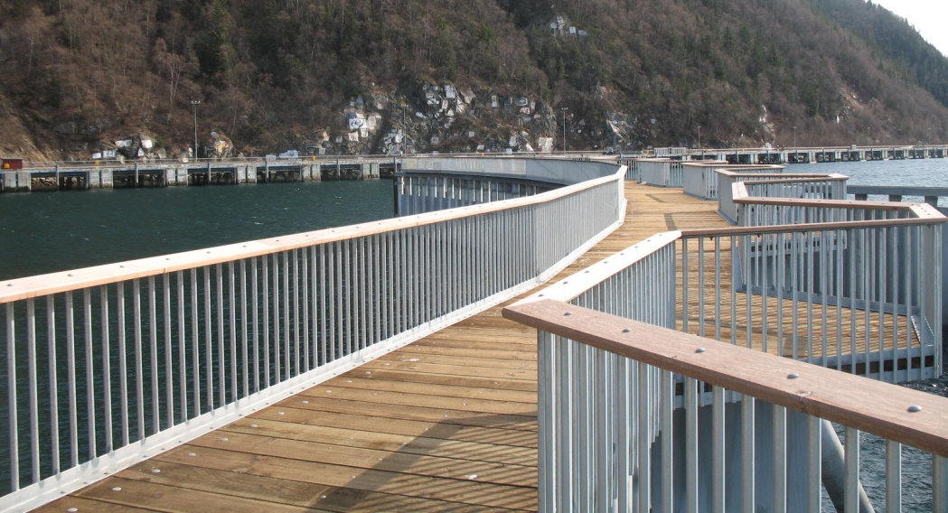
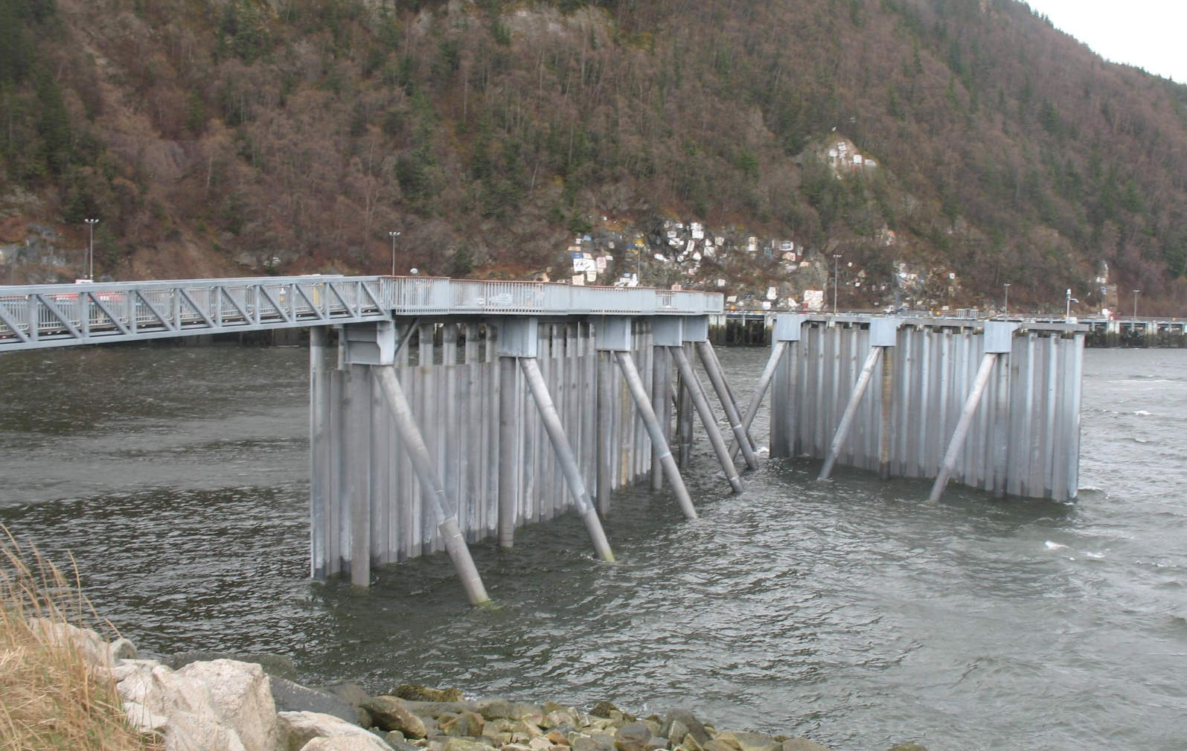
SOUTH PORTAGE COVE HARBOR EXPANSION
Breakwater Technology and Alternatives
Constructed 2009
$7,900 per Foot

Slide 16
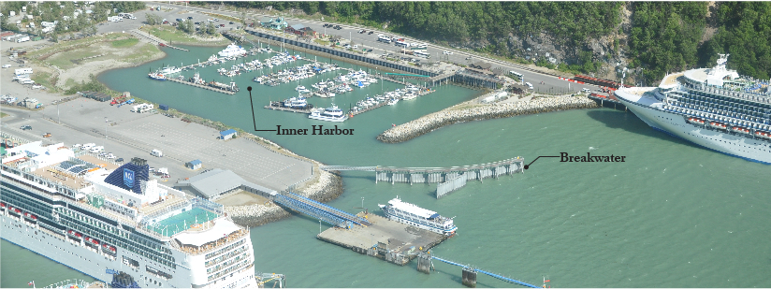
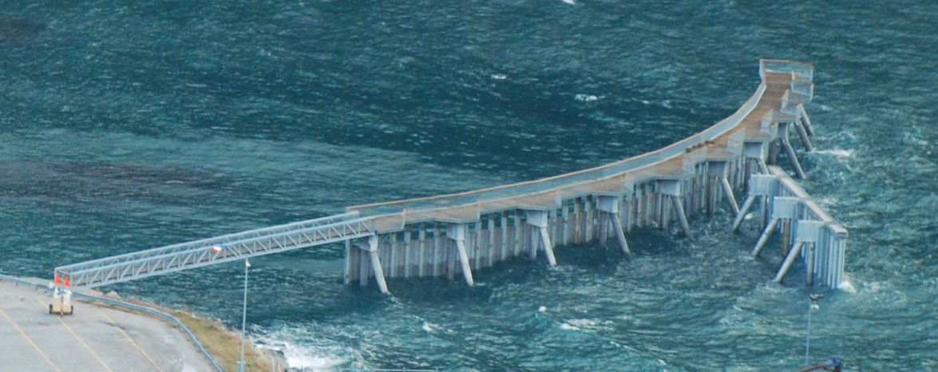
SOUTH PORTAGE COVE HARBOR EXPANSION
Breakwater Technology and Alternatives

Slide 17
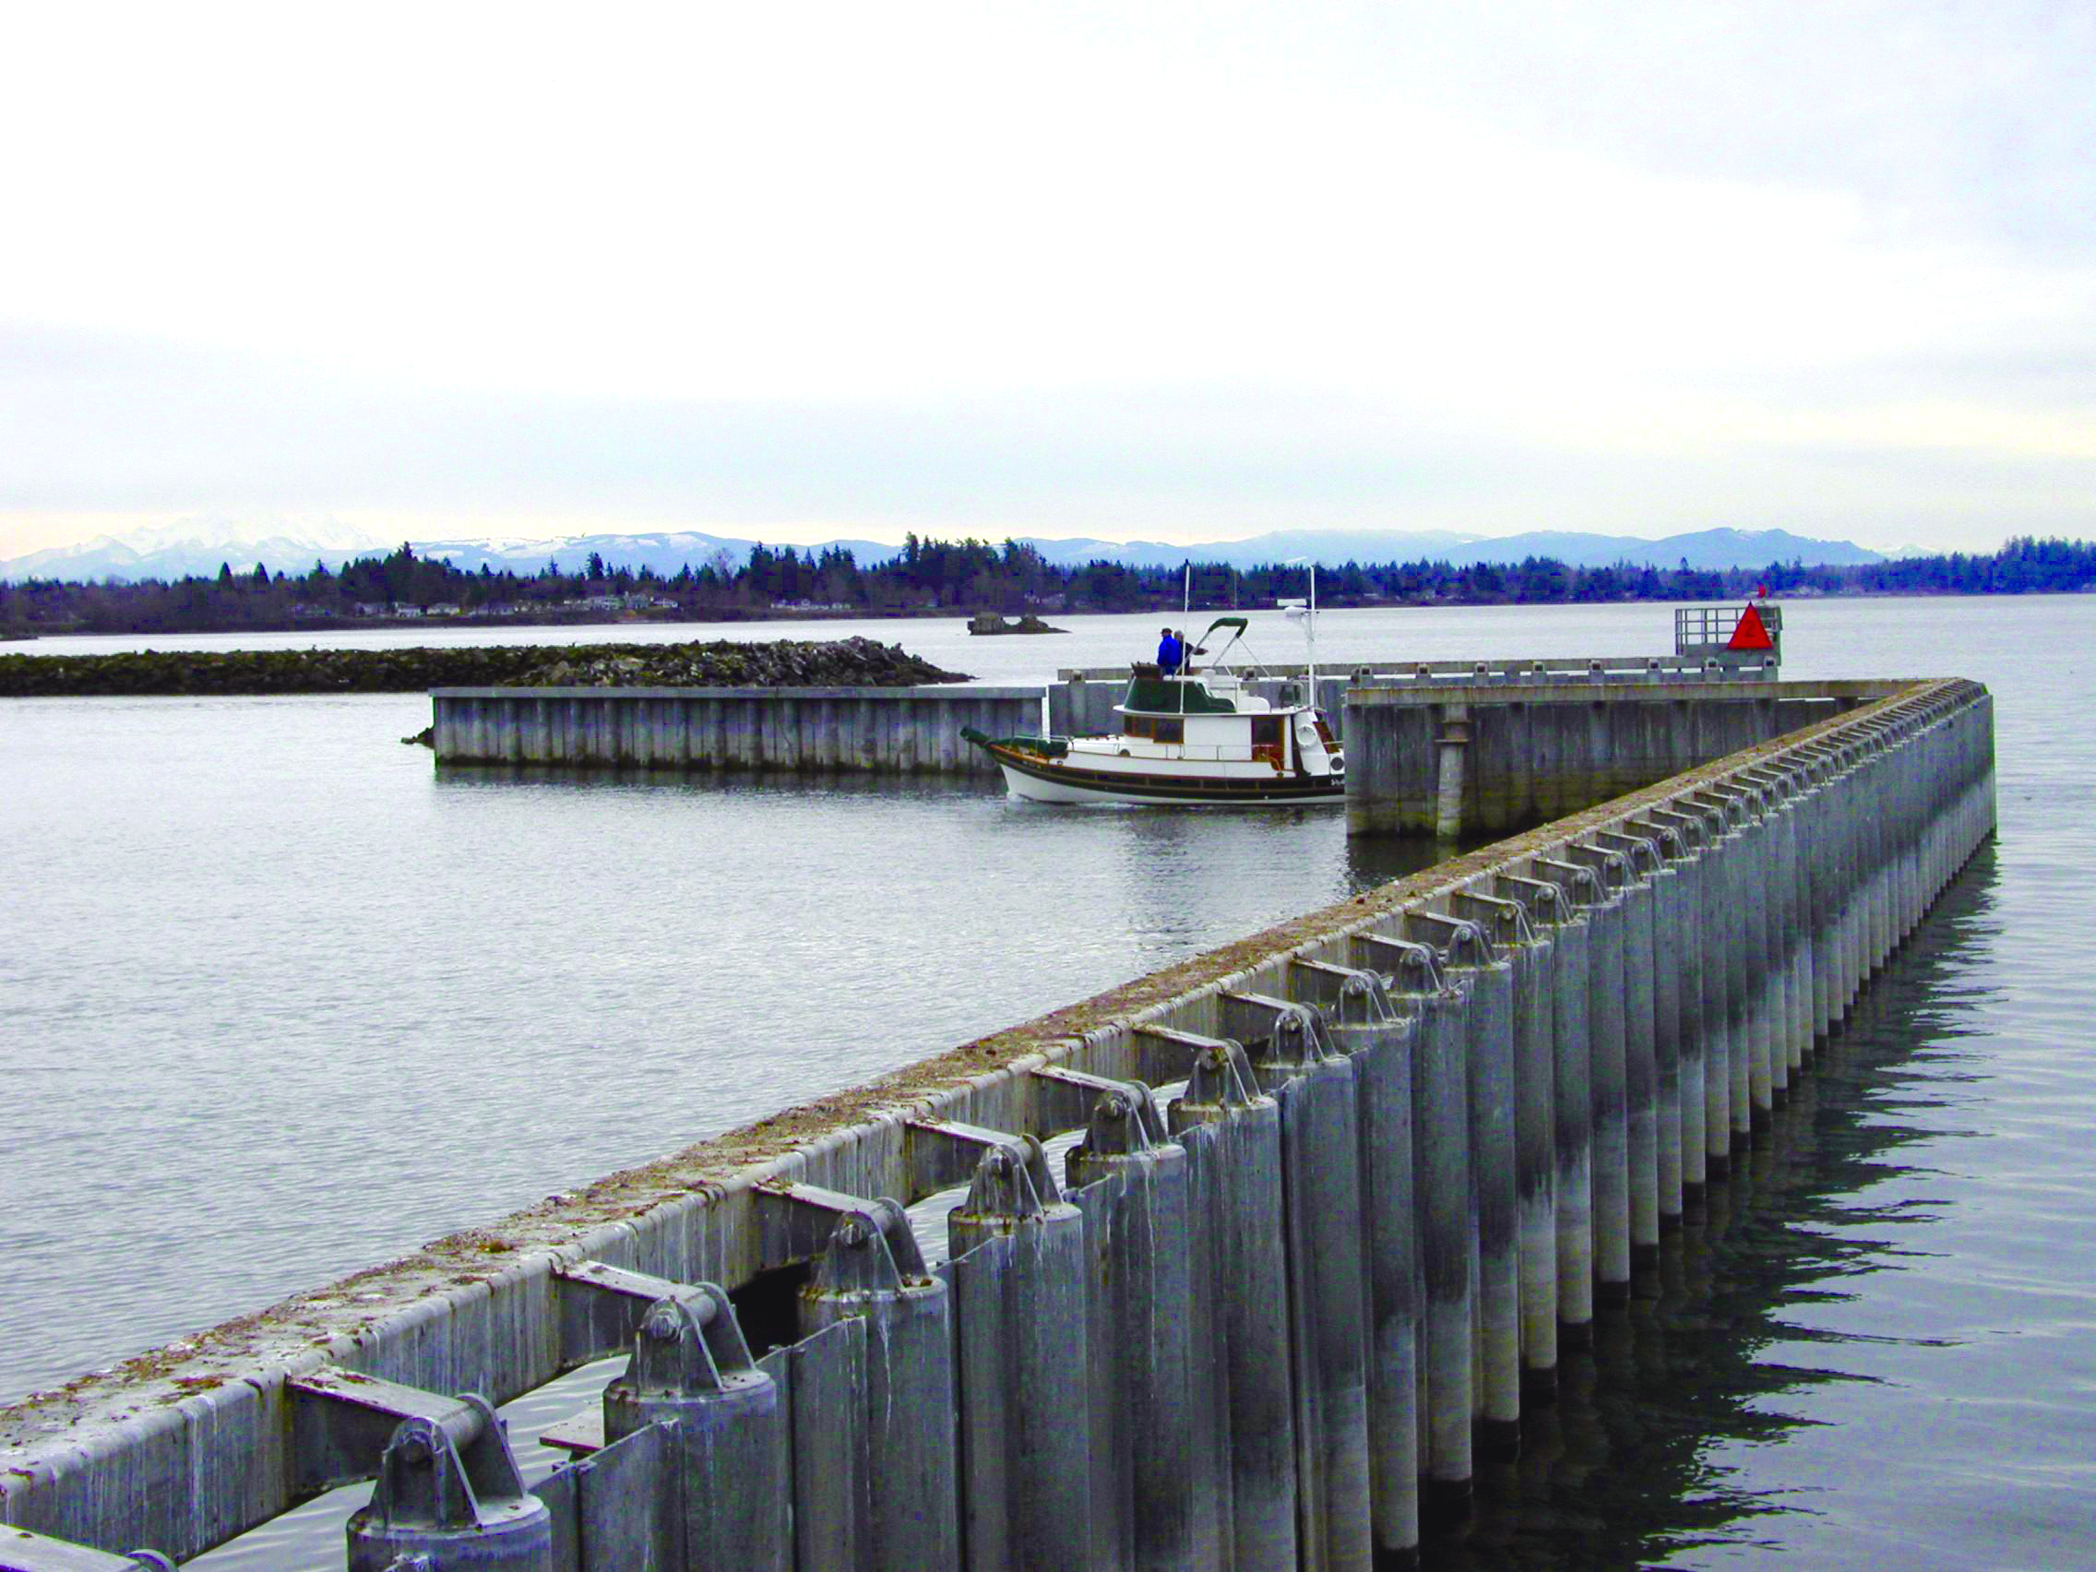
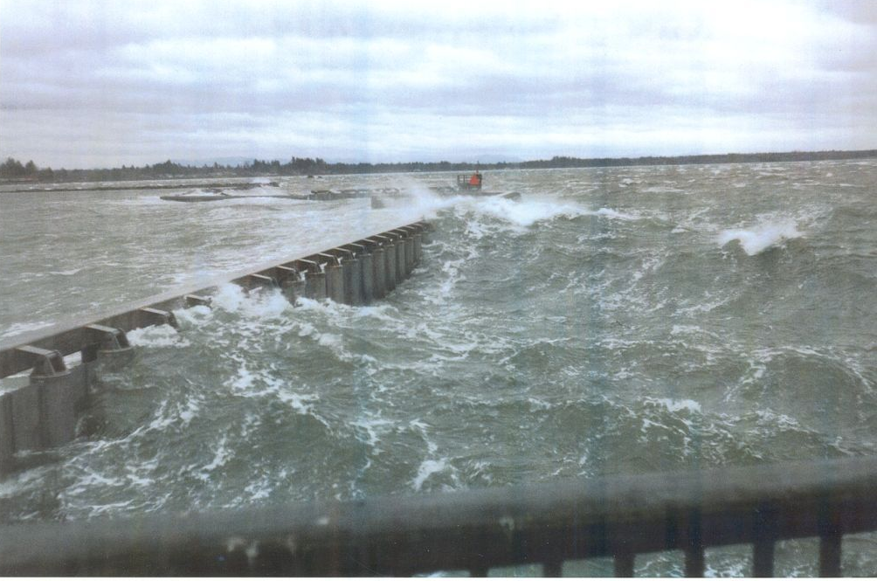
SOUTH PORTAGE COVE HARBOR EXPANSION
Breakwater Technology and Alternatives
Partially Penetrating Vertical Wave Barrier
Blaine, Washington

Slide 18
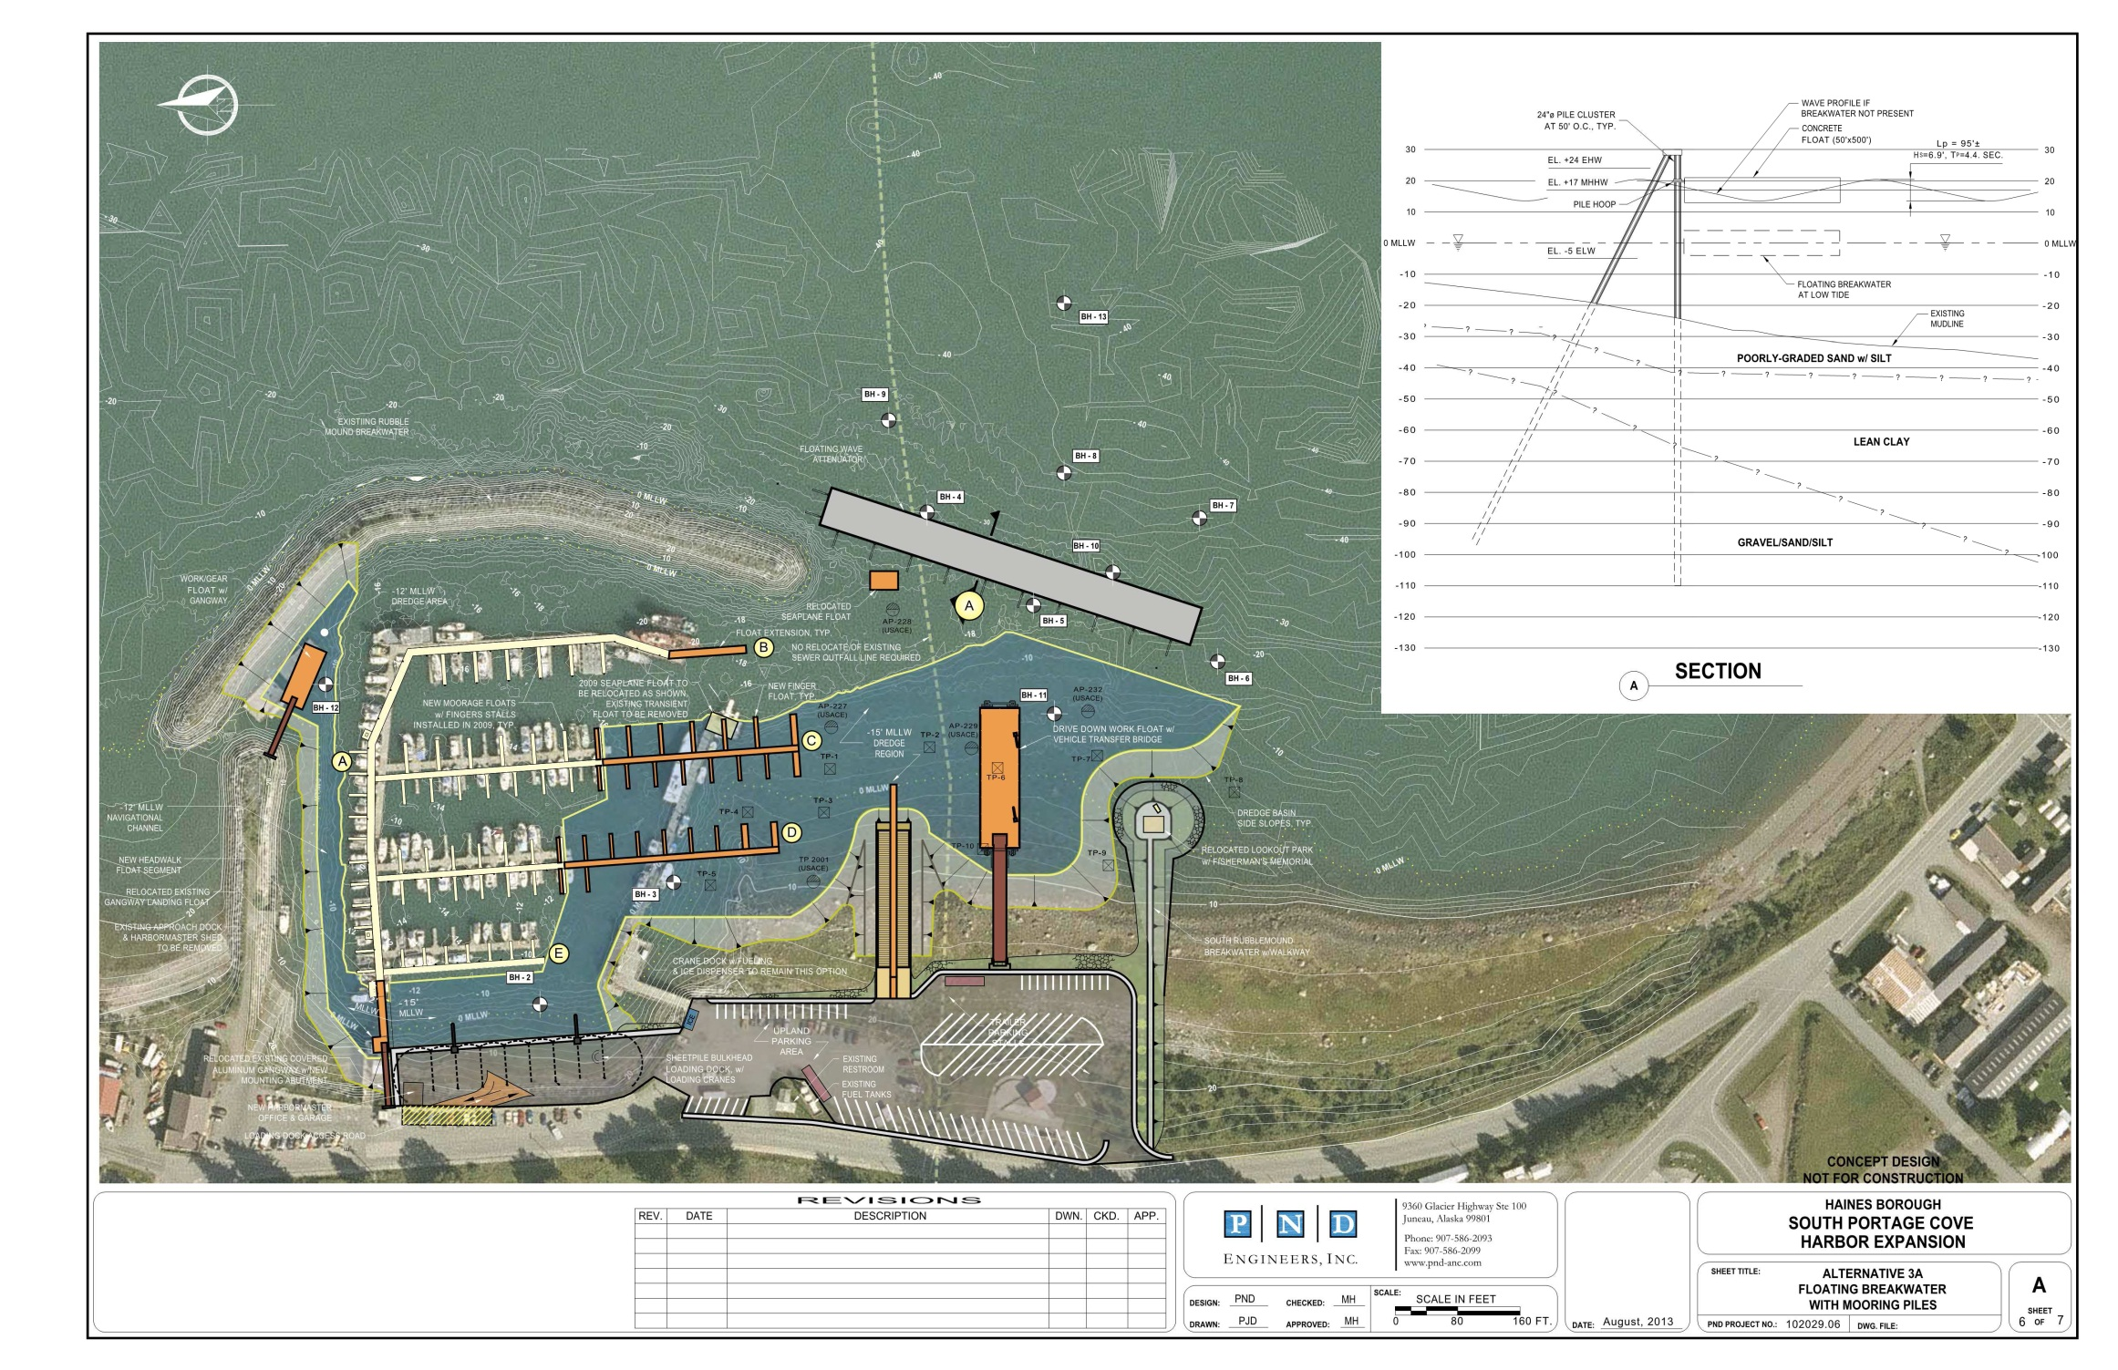
SOUTH PORTAGE COVE HARBOR EXPANSION
Alternative 3A –
Floating Breakwater with Mooring Piles

Slide 19
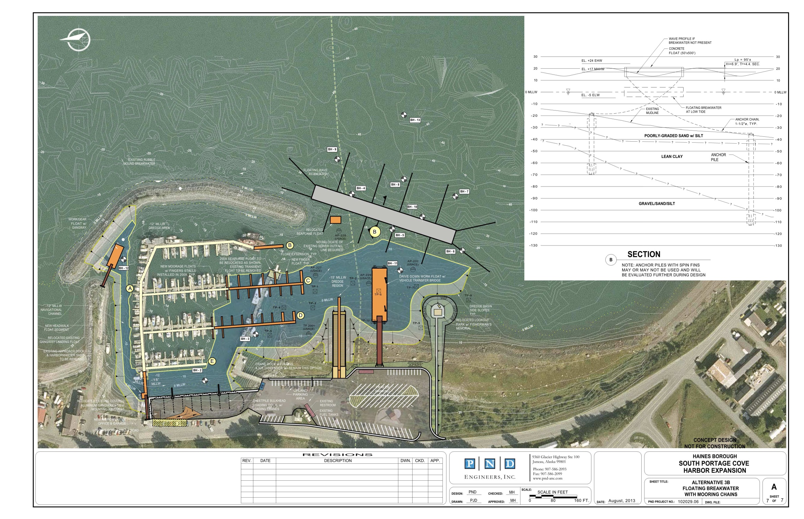
SOUTH PORTAGE COVE HARBOR EXPANSION
Alternative 3B –
Floating Breakwater with Mooring Chains

Slide 20
SOUTH PORTAGE COVE HARBOR EXPANSION
Advantages and Disadvantages
Pros: | Cons:
A floating breakwater also can be used for mooring small commercial or recreational boats. Floating structure moves with the tide and does not block views outside the harbor. Can be moved in the future Reuse of existing floating structures that may be available (old concrete pontoons, barges, caissons and used breakwaters) is sometimes possible and can be a cost-effective means of providing a breakwater. | The engineering and design is more complex than a rubble-mound breakwater. The structure moves and has load concentrations at the mooring hoops and connections, increasing the risk of wear, damage and structural fatigue. Floating wave attenuator performance is sometimes difficult to predict accurately without a large scale physical model. The height of the transmitted wave under the float has more uncertainty than a fixed barrier.

Slide 21
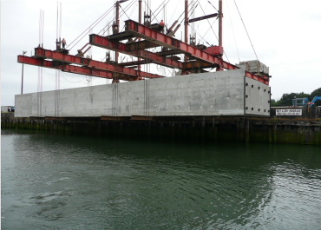
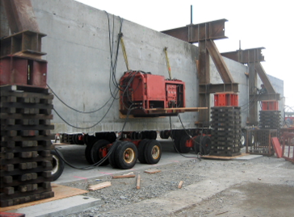
SOUTH PORTAGE COVE HARBOR EXPANSION
Breakwater Technology and Alternatives
Floating Breakwater Fabrication
Port of Bremerton, Washington
1400’ x 24’ x 10’ deep
$6,000 per foot

Slide 22
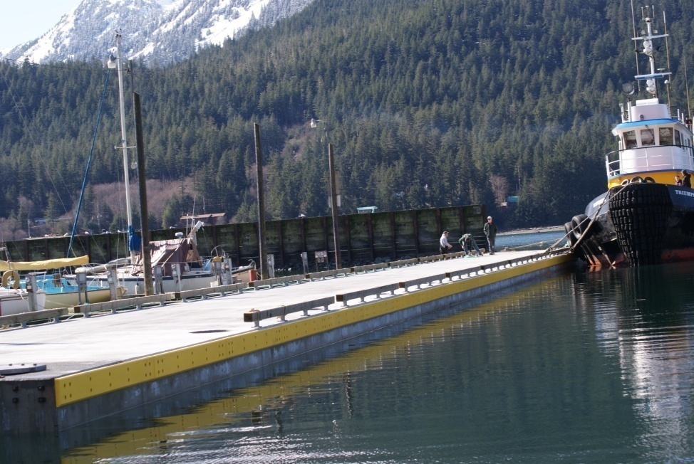
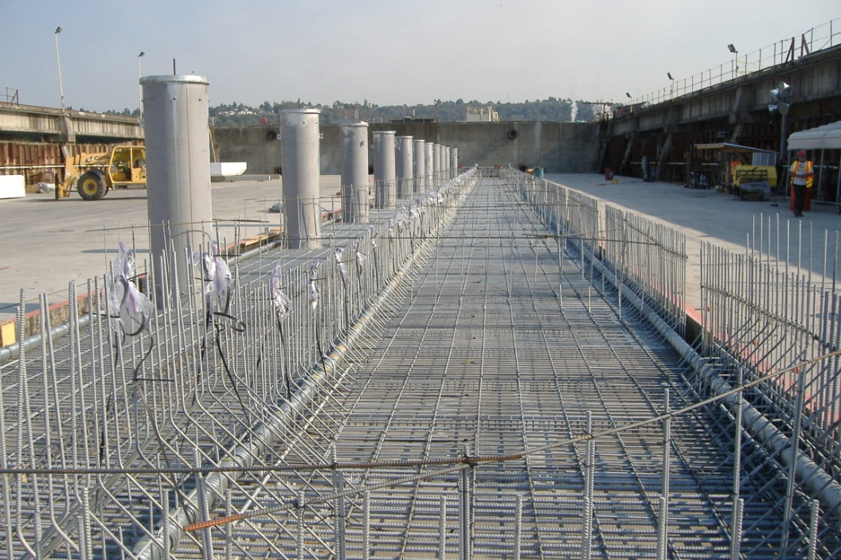
SOUTH PORTAGE COVE HARBOR EXPANSION
Breakwater Technology and Alternatives
Douglas Harbor Floating Breakwater – Currently Tied-off at Aurora Harbor, 230’ x 18’ x 8’ deep
Juneau, Alaska

Slide 23
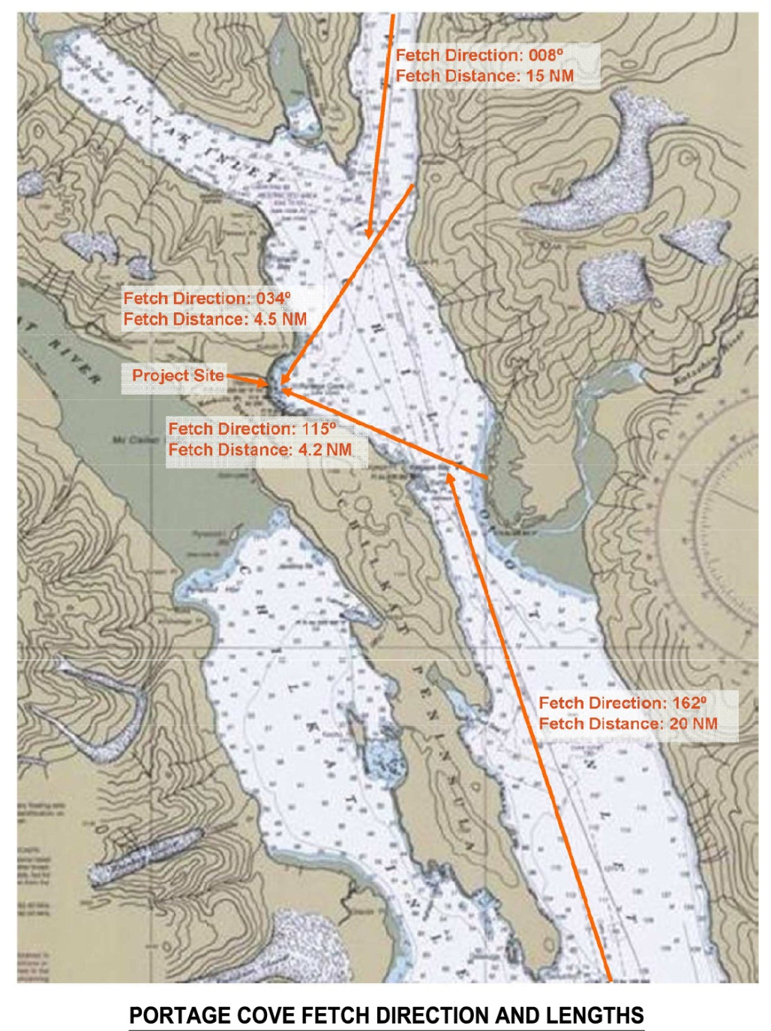
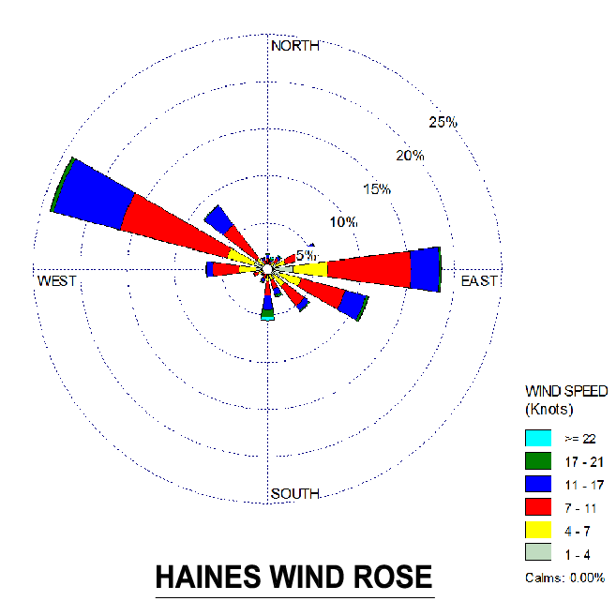
SOUTH PORTAGE COVE HARBOR EXPANSION

Slide 24
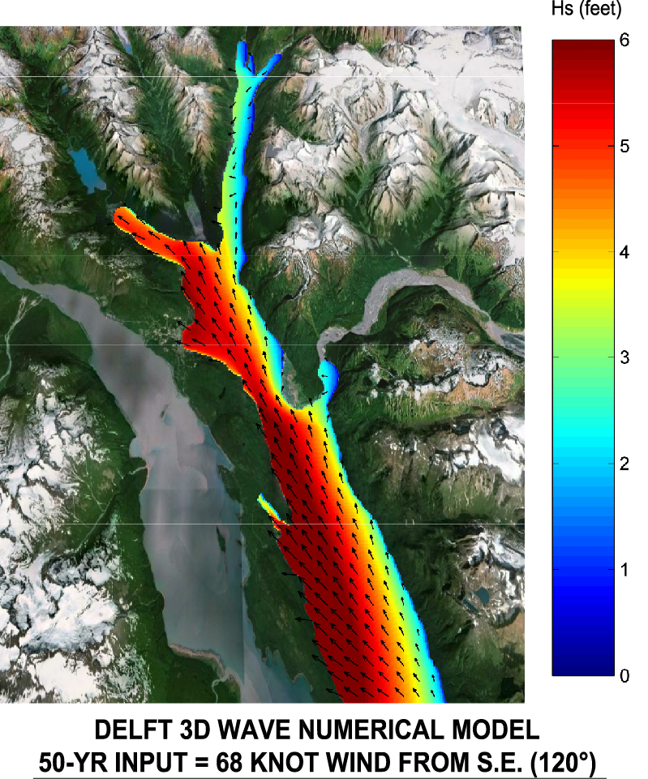
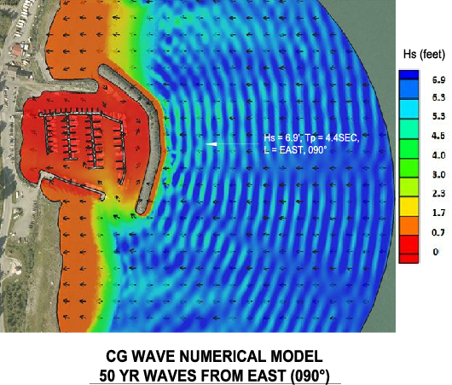
SOUTH PORTAGE COVE HARBOR EXPANSION

Slide 25
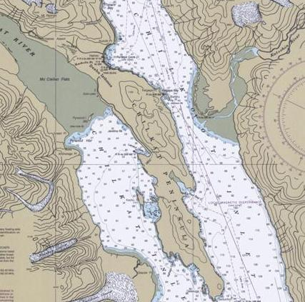
SOUTH PORTAGE COVE HARBOR EXPANSION
Project Site

Slide 26
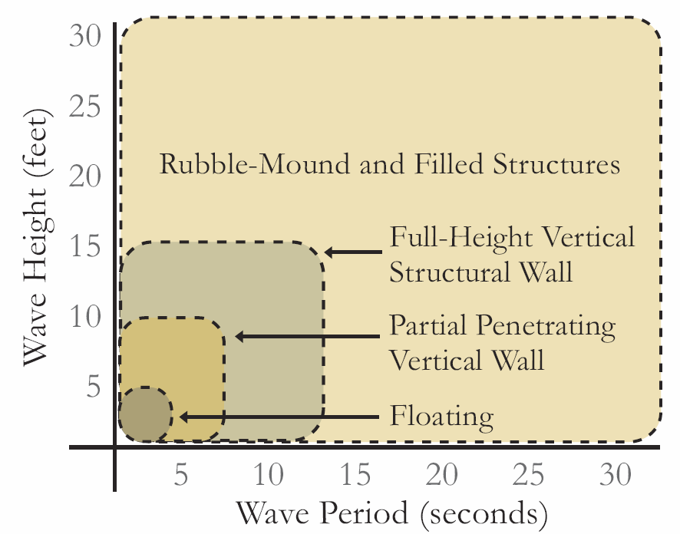
SOUTH PORTAGE COVE HARBOR EXPANSION
Breakwater Technology and Alternatives
Breakwater Types
for Typical Range of Wave Height & Period
Typical Design Conditions:
• Wave Loads and Currents
• Poor Soils
• Scour
• Corrosion
• Sensitive Ecosystems
• High Tide Range
• Ice
• Earthquakes
• Shoreline Erosion/Accretion

Slide 27
SOUTH PORTAGE COVE HARBOR EXPANSION
Summary and Recommendations
 | Breakwater Alternative | Initial Cost ($ million) | 50 year Life-Cycle Cost | Comments
1 | Rubble-Mound (rock) Breakwater w/Wick Drains | $16.0 M | $16.6 M | Wick drains spaced 3 feet on center are needed at an installation cost of approximately $1.5 million to allow the soft sediments to consolidate during a 215 day construction period. The project cannot be feasibly constructed without wick drains. Costs assume relatively expensive locally sourced rock. Costs may be reduced by sourcing rock from outside SE Alaska.
2 | Partially Penetrating Wave Barrier | $7.8 M | $8.7 M | The least cost alternative, but with higher maintenance costs than a rubble-mound breakwater because of the need to maintain the corrosion protection system.
3a | Floating Breakwater (Chains/Anchors) | $11.5 M | $12.6 M | A floating breakwater can also provide moorage for vessels, but has the least wave protection, and highest maintenance costs and risk.
3b | Floating Breakwater (Piles) | $11.9 M | $13.3 M | A floating breakwater moored with pile clusters provides better wave protection than a breakwater moored with anchors and chains, but with higher load concentrations and risk.

Slide 28
SOUTH PORTAGE COVE HARBOR EXPANSION
CGWAVE Animation – SE Waves

Slide 29
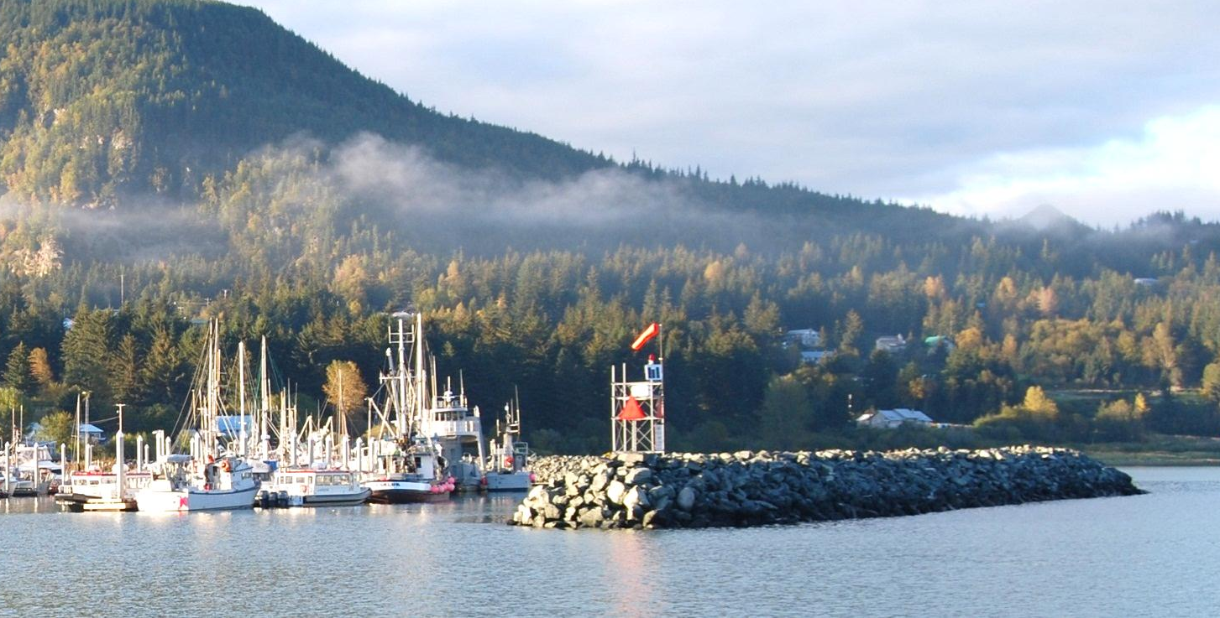
CONTACT
PND Engineers, Inc.
9360 Glacier Highway, Suite 100
Juneau, Alaska 99801
Phone: 907.586.2093
Dick Somerville, P.E.
e-mail: dsomerville@pndengineers.com
1736 Fourth Avenue S, Suite A
Seattle, Washington 98134
Phone: 206.624.1387
Mike Hartley, P.E.
e-mail: mhartley@pndengineers.com
Nels Sultan, Ph.D., P.E.
e-mail: nsultan@pndengineers.com

